Slide 1

Sharding
Nilap Shah
(MongoDB Certified DBA + Developer + Trainer)
https://www.linkedin.com/in/nilap-shah-8b6780a/
Mobile : 9537047334 (WhatsApp)

Slide 2

Sharding
A Sharding is group of replicasets that maintains different data across all instances within same set
It provides high scalability
It improves read performance as well as write performance
Query Router: provides interface between client application and sharded cluster
Config servers store metadata and configuration settings for the cluster

Slide 3
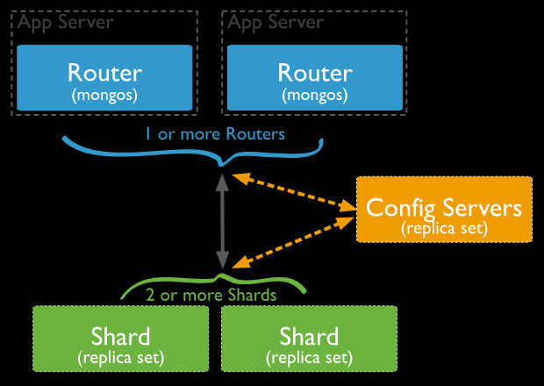
Sharding Architecture

Slide 4
Shard Key
Choose appropriate shard key while implementation
It should be able to find unique values and we are able to split the chunk
Default chunk size 64 MB
Once you shard collection no way to change shard key or you can not unshard the collection
Balancer is background process it will distribute data across all shards

Slide 5
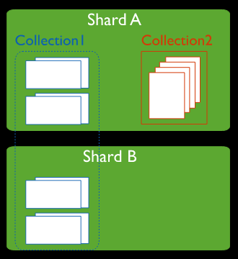
Sharded / Unsharded Collection

Slide 6
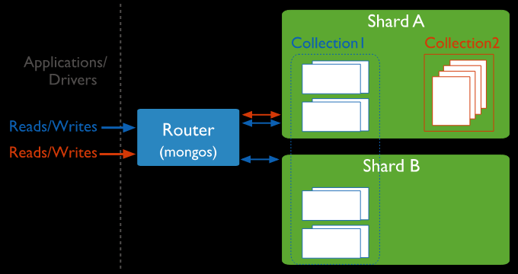
Application + Sharded cluster

Slide 7
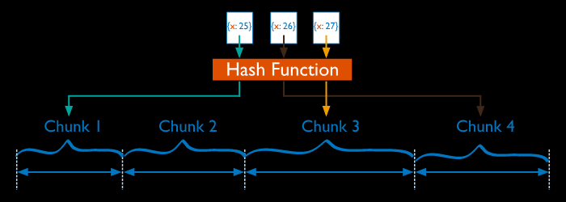
Hash based Sharding

Slide 8
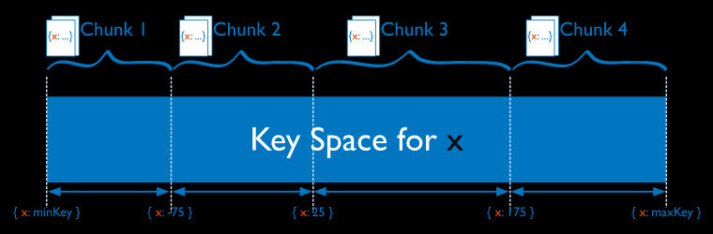
Range based Sharding

Slide 9
Move Primary Shard / Remove Shard
db.adminCommand( { movePrimary : " shard0001 ", to : "shard0002" } )
db.adminCommand( { removeShard : "bristol01" } )

Slide 10
Config Servers
Holds metadata about whole sharded cluster including number of sharded collections and with chunks information
Uses Read Concern as Majority
Always perform backup of config servers because once you loose data there is no way to recover data

Slide 11
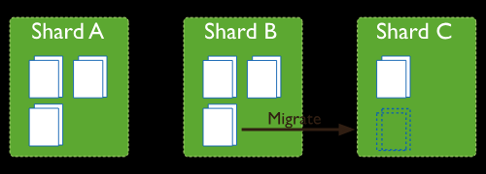
Migration Sharding

Slide 12
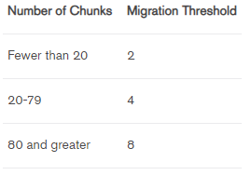
Migration Threshold

Slide 13
Thank you
Linked in Profile (Mobile-9537047334)
https://www.linkedin.com/in/nilap-shah-8b6780a/

Slide 14
Nilap Shah
MongoDB (Trainer/DBA/Developer)
Location : Ahmedabad/Banglore
Linked in Profile (Mobile-9537047334)
https://www.linkedin.com/in/nilap-shah-8b6780a/

